Slide 1
MATLAB & Communication Simulations
张昱
Tel: 13858059559
Office：信息B508
Email: yzhang@zjut.edu.cn

Slide 2
References
英文版：
《MATLAB编程(第四版)(影印版)》，Stephen J. Chapman著，科学出版社
Contemporary Communication Systems Using MATLAB, John G. Proakis, Masoud Salehi等著，CL Engineering，2012年1月第3版
中文版：
《现代通信系统》（MATLAB版）（第二版），（美）普罗克斯（Proakis，J.G）等著，刘树棠译，电子工业出版社，2005年4月第1版
《通信原理：基于Matlab的计算机仿真》，郭文彬 杨鸿文 桑林等编著，北京邮电大学出版社，2015年9月第2版

Slide 3
微信群
线上教学：https://mooc1-1.chaoxing.com/course/206480752.html

Slide 4
Schedule：
- 8 classes，8 experiments，
Final exam：the last experiment
Location：1st- 4th :语312, 5th-8th :语314,

Slide 5
Grading of the course：
Class attendance and performance: 10%
Lab (and the reports): 20%
Course report (or preview work): 20%
Overview of some technology on communications and its development in our country, as well as a related MATLAB simulation example. (2 Pages)
Final exam: 50%

Slide 6
Overview of some technology on communications and its development in our country, as well as a related MATLAB simulation example. (2 Pages, with MATLAB source code and comments)
E.g., OFDM, MIMO, Modulation scheme, receiver, channel coding, source coding, channel estimation, resource allocation, communication system optimization, locating (Beidou), Radar sensing….

Slide 7
Course Content
MATLAB basics
Signal and linear systems, Random processes
Analog modulation
Baseband digital transmission
Digital transmission via carrier modulation
Wireless channels

Slide 8
Preface
MATLAB is a high-level language and interactive environment for numerical computation, visualization, and programming. Using MATLAB, you can analyze data, develop algorithms, and create models and applications.
Use MATLAB for a range of applications, including signal processing and communications, image and video processing, control systems, test and measurement, computational finance, and computational biology.

Slide 9
Preface
What will we learn from this course？
MATLAB software；
MATLAB Language, Grammar；
Communication system simulation using Matlab；

Slide 10
Desktop Panels
The desktop includes these Panels:
Current Folder ------ Access your file
Command Window ------ Enter commands at the command file, indicated by the prompt(>>)
Workspace ------ Explore data that you create or import from files
Command History ------ View or return commands that you entered at the command line.

Slide 11
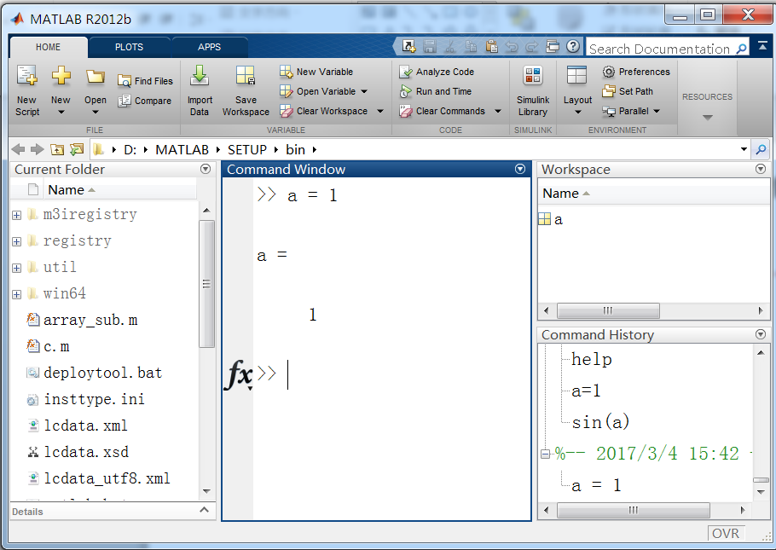
Desktop Panels
Workspace
Command
History
Current Folder
Command window

Slide 12
Desktop Panels
Array Editor
Double click some variable in Workspace Browser;
Observe or operate the date in array.

Slide 13
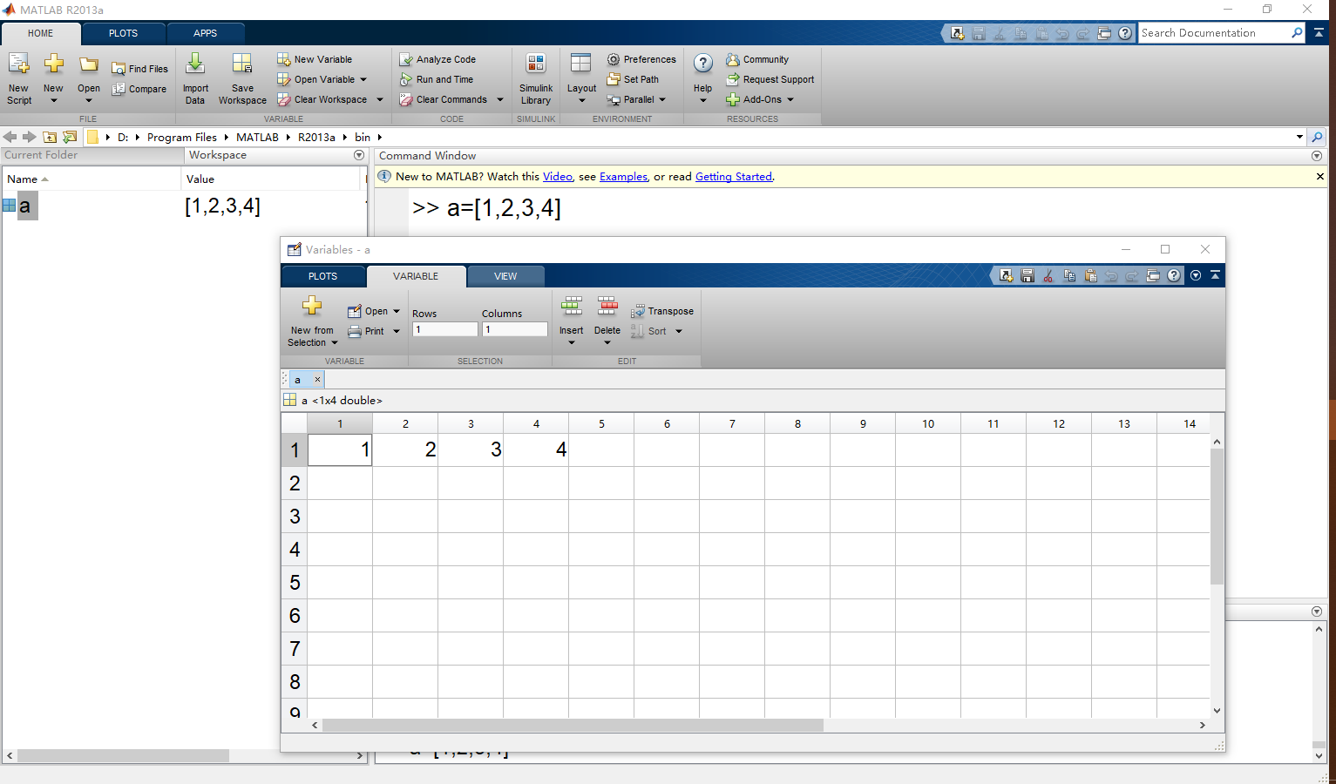
Desktop Panels

Slide 14
MATLAB Basics
Variable types, assigments
Scalars： a=10， a=10+j；
Vectors：a=[1 3 5], a=[1,3,5], a=1:2:7, a=[1;3;5]
Matrices：A=[1,2,3;4,5,6;7,8,9]
‘Ans’ variable
Multi-dimensional array（e.g., 3-d array）
Operations on scalar (complex number), vector,matrix: (plus, multiply, element-wise multiply,division,transpose,Hermitian),how to access the data in the array.
E.g.：A*B，A.*B, A/B, A./B, A(1,1),A(:,1),A(1,:), A(:,:)
Notes:
多维数组最后

Slide 15
MATLAB Basics
Some special number:
pi：
Inf，inf：infinity, i.e.,1/0
NaN,nan： not a number, e.g.,0/0
eps：accuracy of the matlab
eps = 2⁻⁵² ≈ 2.2204×10⁻¹⁶

Slide 16
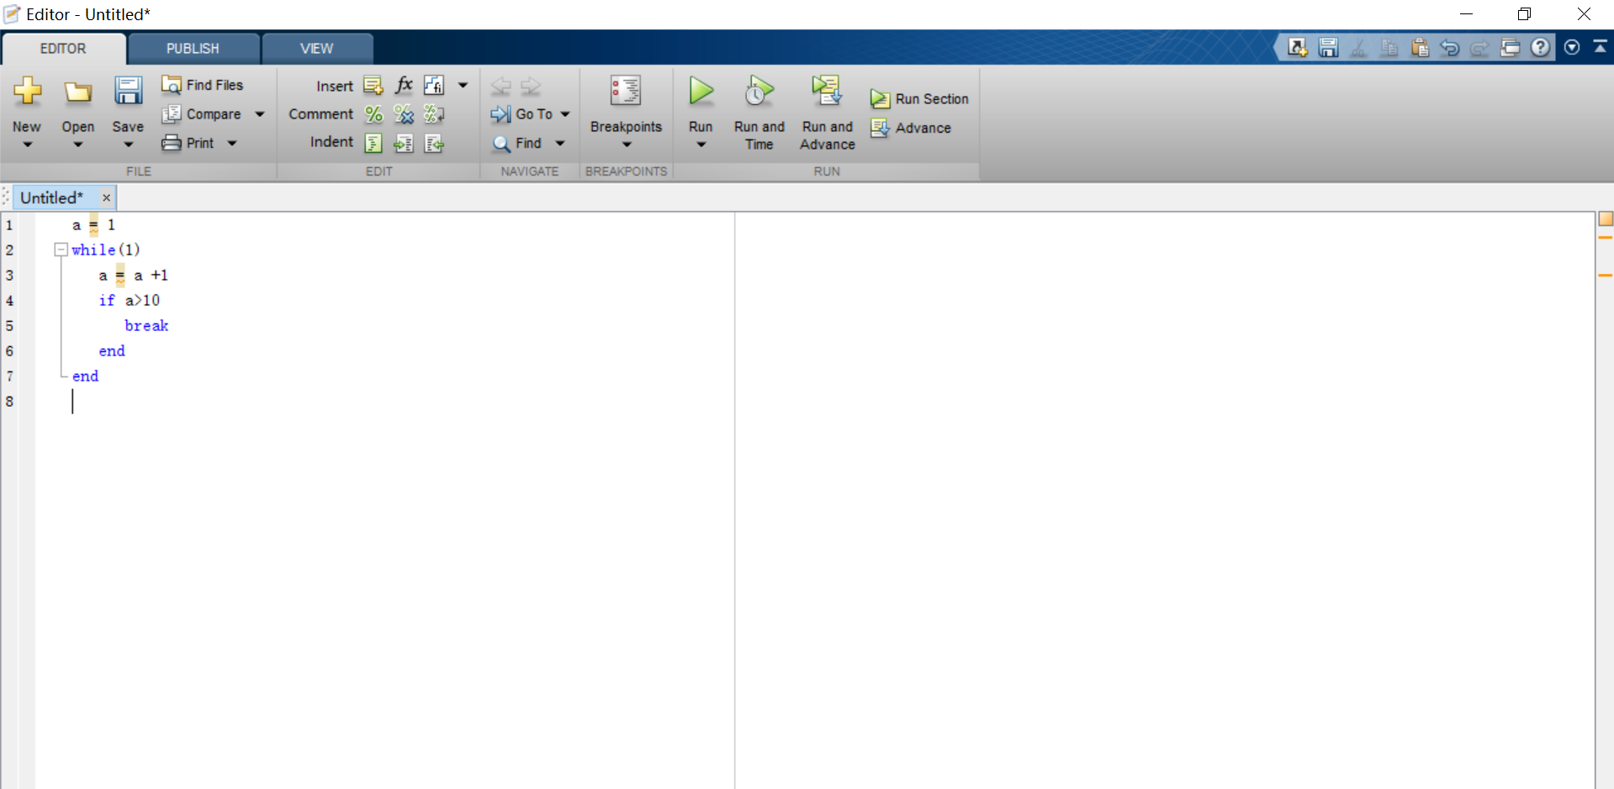
MATLAB .m file
.m file consists of a series of commands.
.m file can be directly executed as if you typed the commands in the command window.

Slide 17
MATLAB Grammar
Control Flow
Condition statement: if
if expression 1
command 1
elseif expression 2
command 2
…
else
command n
end
Notes:
按照书上例子

Slide 18
MATLAB Grammar
Control Flow
Condition statement: switch &case
switch （a）
case 0
command 1
case 1
command 2
…
otherwise
command n
end

Slide 19
MATLAB Grammar
Control Flow
Loop: for and while
for i=1：1：4 (i=1:2:6? )
command 1
end
while condition
command 1
end
‘jump’ command: continue and break

Slide 20
MATLAB General Functions
Matlab function calling：output=function_name(input);
1.Command window
2. .m file
Random number
Name | Description | Name | Description
randn | Normal distribution | rand | Uniformly distributed in [0,1]
randperm | Random permutations

Slide 21
MATLAB General Functions
Trigonometric functions
Name | Name
acos(x) | cos(x)
acot(x) | cot(x)
acsc(x) | csc(x)
asec(x) | sec(x)
asin(x) | sin(x)
atan(x) | tan(x)
atan2(x) | hypot

Slide 22
MATLAB General Functions
Exponetial and logarithm functions:
Name | Description | Name | Description
exp(x) | e^{x} | pow2(x) | 2^{x}
expm1(x) | e^{x}-1 | reallog(x) | x should be real, non-negative
log(x) | ln(x) | realpow(x,y)
log1p(x） | ln(1+x) | realsqrt(x)
log2(x) | log₂(x) | sqrt(x) | Square root
log10(x) | log₁₀(x) lg(x) | nthroot(x,n) | N-th root of x

Slide 23
MATLAB General Functions
Complex:
Notes:
A+bi
A+bj
Exp(i)
Sqrt(-1)

Slide 24
MATLAB General Functions
Array and matrix:
Name | Description | Name | Description
ones | All 1 | zeros | All zero
length | ^{length} | size | Dimension of array
sum | sum | mean | Mean of array
det | Determinent | inv | inversion
eig | Eigen value | svd | Sigular value
reshape | Reshape the array | max | maximum
sort | Sort the array

Slide 25
MATLAB General Functions
Rounding function
round | Round to the nearest integer
fix | Round toward zero
floor | Round toward -∞
ceil | Round toward +∞
mod | mod(X,Y)＝X - n.*Y， n = floor(X./Y)
rem | rem(X,Y)＝X - n.*Y， n = fix(X./Y)

Slide 26
MATLAB General Functions
Figure plotting
Name | Description | Name | Description
plot | Plot figure | figure | Create an empty figure window
subplot | Plot subfigure | semilogy | Plot with log scale for y-axis
loglog | log scale for x and y-axis | stem | Plot discrete sequence data
xlabel | Label x-axis | ylabel | Label y-axis
title | Create title | legend | Create legend for the curves
hold | Retain current graph | grid | Grid lines for the plot

Slide 27
MATLAB General Functions
Plot function:
To plot one curve：plot(x,y)
To plot multiple curves：
plot（x1，y1，x2，y2，…，xn，yn）
We can set different attributes on each curve：
plot（x1，y1，option 1，x2，y2， option 2，…，xn，yn， option n）
To plot subfigures：Subplot（m,n,i），following by plot().
Property Editor –Figure window
Notes:
直接看程序
以及help
编号：按行顺序

Slide 28
MATLAB Function Creation
In Matlab, we can create functions by ourselves, in 2 forms:
- an individual .m file
- in the main .m file
Format：
An example：create a function: Input: ‘init’, ‘step’, ‘count’
Output: two arrays with length of ‘count’, starting from ‘init’, step of +`step’ and –`step’, respectively
function [outputs]=function_name(inputs)

